Slide 1

BASIC OF CIVIL ENGINEERING (TCE 101)
UNIT- 2 Lect 4
.

Slide 2
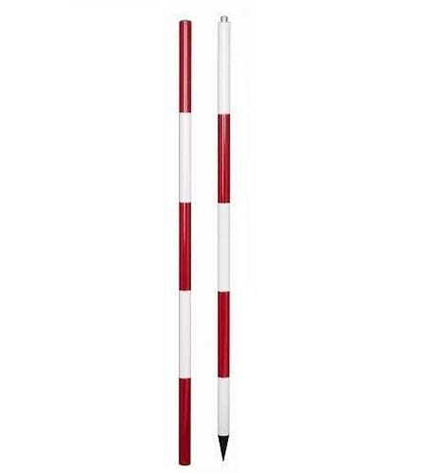
Ranging in Surveying
DEFINITION
Ranging is the process of establishing many intermediate points to measure the survey lines in linear measurement. When the length of the surveying line is longer than the length of the measuring chain, the line can be measured by using intermediate points along with it by ranging.
INSTRUMENTS USED
Ranging can be done by using the following instruments:
Ranging rods
Offset rods
Ranging poles
Ranging rods are vertical rods used to mark survey points having 2-3 m height. It is painted with bands of red and white 20 cm each.
Offset rods are used for measuring offset of short lengths. It is similar to ranging rod and is usually of 3m lengths.
Ranging poles are used for spotting and marking the position of survey stations. If a range rod is longer than 12 feet, it’s called a ranging pole.

Slide 3
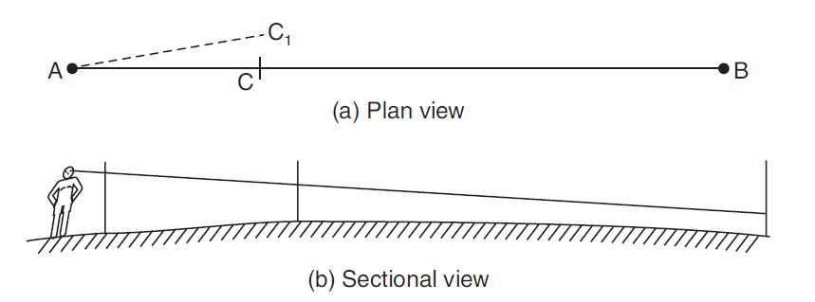
Types of Ranging
Ranging can be of two types
Direct ranging
Indirect ranging
Direct Ranging
Direct ranging is adopted when the two survey stations are inter-visible i.e. the two end points of the survey line are visible..
For example, A and B are the two inter-visible points at the survey end line. At points A & B ranging rods are fixed. Then, another person takes the ranging rod and fixes or establishes an intermediate point C between the line AB. The surveyor at point A then signals another person at the intermediate points so that the ranging rod is in perfect line with the endpoints A and B. Hence, the intermediate points are determined.

Slide 4
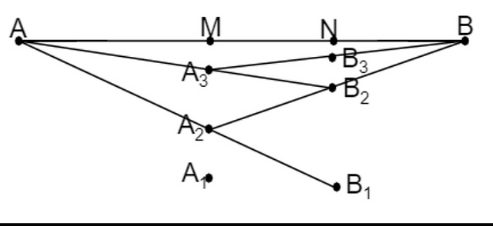
Types of Ranging
Indirect Ranging
It is used when the two endpoints of the survey line are either not inter-visible or the two points are at a very long distance. For instance, let A and B be the points that are not visible. Now following steps are carried out:
A1 and B1 are considered such that A and B1 are visible from A1 and A1 and B are visible from B1.
A1 is shifted to a position A2 such that A, A2, and B1 are in the same line.
Similarly, B1 is shifted to B2 such that A2, B2, and B are in the same line.
The process is repeated until all the points are in the same line and hence intermediate points are located.

Slide 5
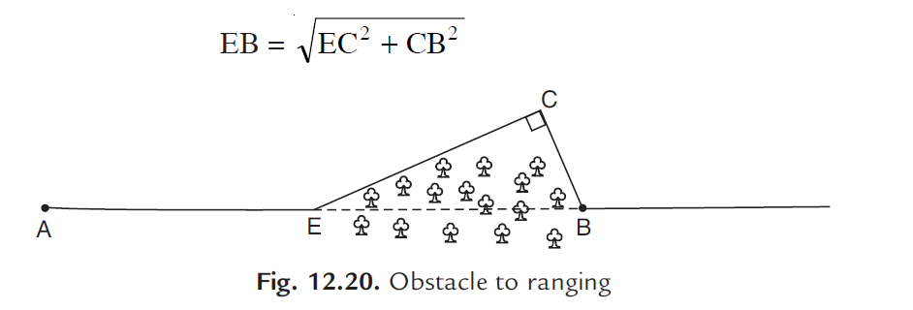
Obstacle to Ranging
These obstacles can be further classified into the following categories:
(a) Both ends of the line are visible from some intermediate points. Intervening ground is an example of such obstacle. By resorting to reciprocal ranging this difficulty can be overcome.
(b) Both ends of the line may not be visible from intermediate points on the line, but may be visible from a point slightly away from the line. Intervening trees and bushes are the examples of such obstacles. This obstacle to chaining may be overcome by measuring along a random line as shown in Fig. In this case required length.

Slide 6
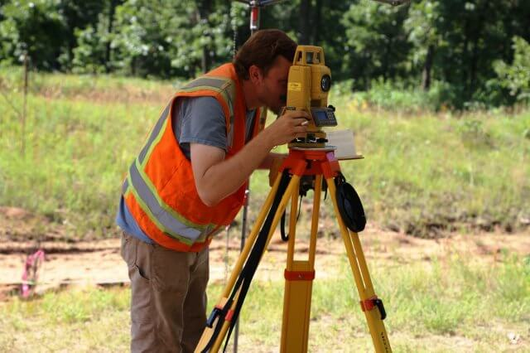
Theodolite
Theodolite is a measurement instrument utilized in surveying to determine horizontal and vertical angles with the tiny low telescope that may move within the horizontal and vertical planes.
Followings are the major uses of theodolite:
Measuring horizontal and vertical angles
Locating points on a line
Finding the difference in the level
Prolonging survey lines
Ranging curves
Setting out grades

Slide 7
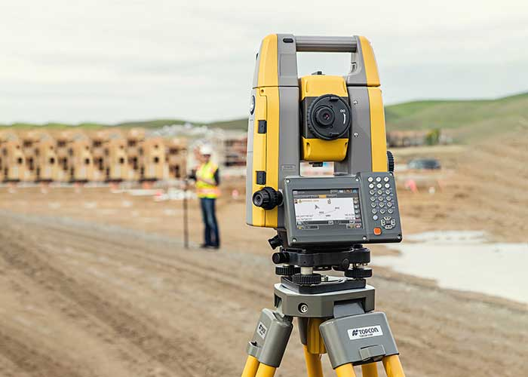
Total Station
A Total Station is a modern surveying instrument that integrates an electronic theodolite with an electronic distance meter.
Total Stations use electronic transit theodolites in conjunction with a distance meter to read any slope distance from the instrument to any particular spot. They are hence two essential surveying instruments in one and when used with other technology such as mapping software are able to deliver the ‘total’ surveying package, from measuring to mapping.

Slide 8
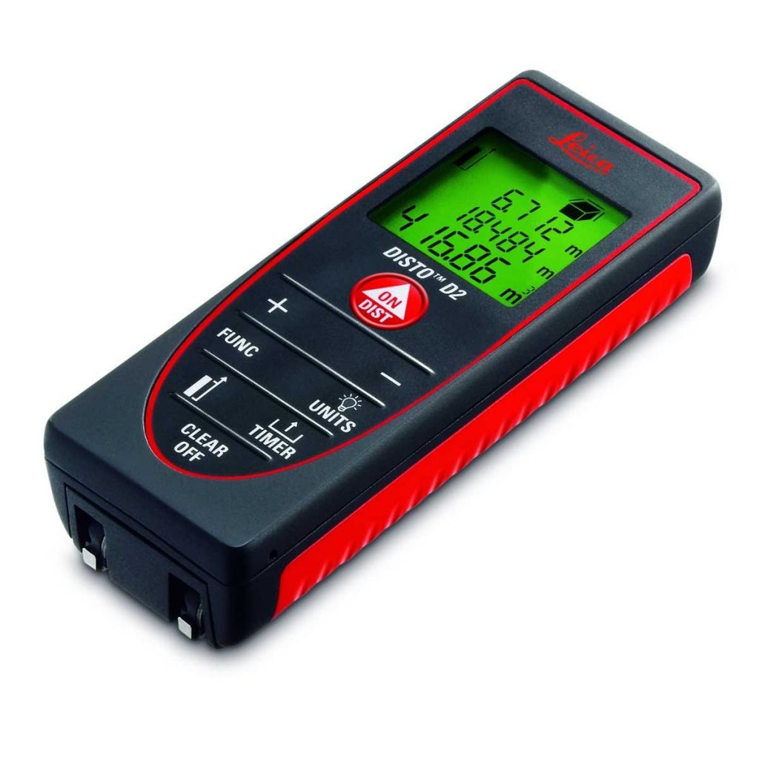
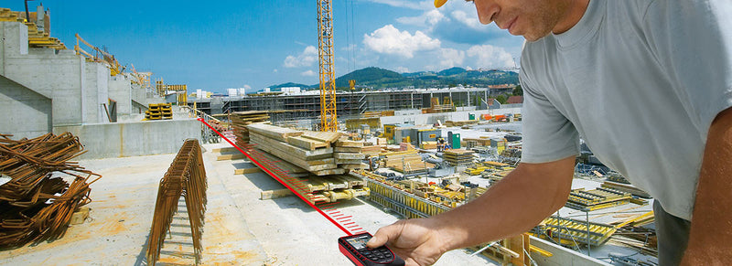
Laser Distance Measurement
Laser tape measures, also known as laser distance measures or laser distance meters, are a modern alternative to the traditional tape measure.
Measurements are taken by sending out a pulse of laser light to a defined target and then measuring the amount of time it takes for the refection to return.
This allows for extremely accurate readings, even over large distances.
Additionally, on-board functions allow the device to add, subtract, calculate area and volume, triangulate and a range of other functions.
These have a huge benefit to the user as complex, time-consuming calculations can be made quickly, easily and with high degrees of accuracy.

Slide 9
Global Positioning System
The term GPS full form is “Global Positioning System” which is a satellite navigation system that provides location and time information in all climate conditions to the user.
GPS is used for navigation in planes, ships, cars, and trucks also.
GPS provides continuous real-time, 3-dimensional positioning, navigation, and timing worldwide.
Working of GPS
GPS uses a network of satellites, which communicate with receivers on the ground. When a receiver requests data to calculate its location, four or more GPS satellites will communicate with the receiver, sending the position of the satellite, the time the data was transmitted and the distance between the satellite and the receiver. The information collected from these satellites then calculates the latitude, longitude and height of the receiver. If the receiver is moving, continuous data collection can be used to calculate the changing position of the receiver over time, which can be used to calculate speed.

Slide 10
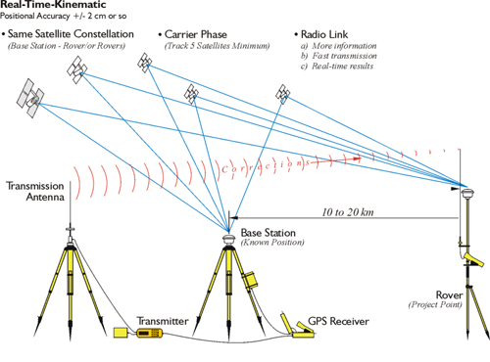
Global Positioning System
Working of GPS

Slide 11
Geographical Information System
GIS is short for Geographic Information System. It is a collection of computer software and information which is used for viewing, analysing, managing and displaying geographical data.
In general, it allows users to search for information about specific geographical areas, analyse spatial information, edit the data and create maps, charts and reports that show users the results in visual forms.
Uses
Environmental Geography – to analyse the impact people have on the environment.
Physical Geography – to study the elements of atmosphere, biosphere and geosphere.
Emergency Management Information System – to give real time data to emergency responders about the geographical layout.
Health Geography – to use geographical information to study health related issues such as disease and illness.
Economic Geography – to study economic activities across the earth.
Transportation Geography – to investigate the spatial interactions of people or things

Slide 12
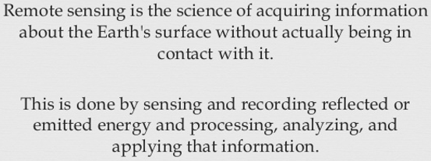
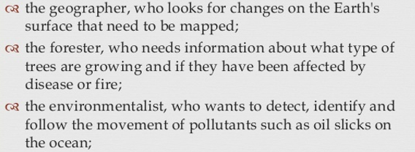
Remote Sensing
Uses of Remote Sensing

Slide 13
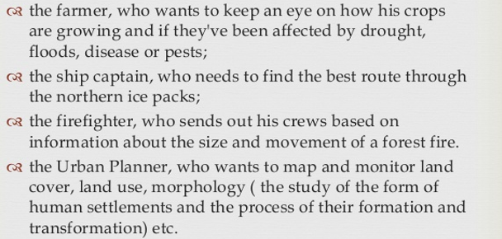
Remote Sensing
Uses of Remote Sensing

Slide 14
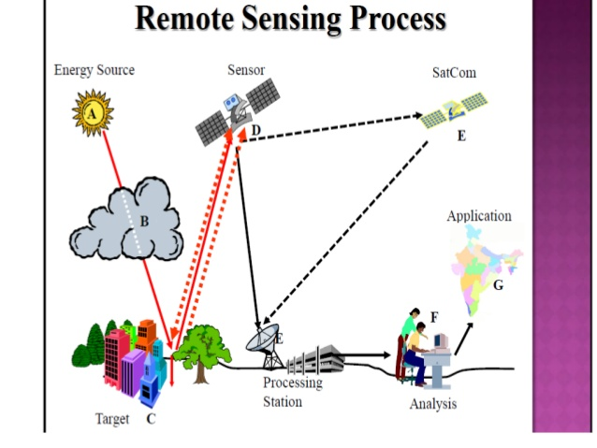
Remote Sensing
Process of Remote Sensing

Slide 15
Thank you

